Slide 1

Gunnison County
Climate Change Mitigation Plan
Notes:
Our goal for this conference is to move from abstract support for lowering greenhouse gas emissions to tangible understanding of the behavior change, policies, and opportunities that will have a predictable and measurable affect on our local emissions.
This day will be focused on numbers and forecasted estimates. We will learn more about where emissions come from now and what factors could be changed that are most likely to effect emissions in the future. In order to get through this we will not be talking about resilience, adaptation, or any of the other really important issues that must be considered relating to climate change. Today is about emission, where they come from and what opportunities exist to lower them.

Slide 2


Past Efforts
Progress on goals from the 2009 Energy Action Plan
CPACE
GVHEAT
Energy Code Adoption
Support and Growth of RTA
Leading by example in building energy efficiency
Deployment of alternative fuel vehicles
Notes:
Gunnison County has been working on this for some time and has made porgres

Slide 3
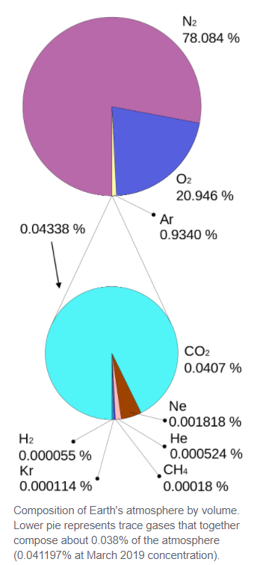
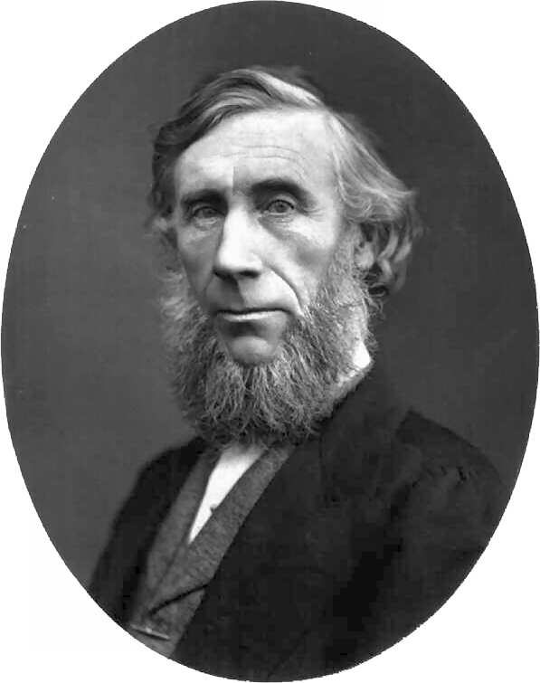
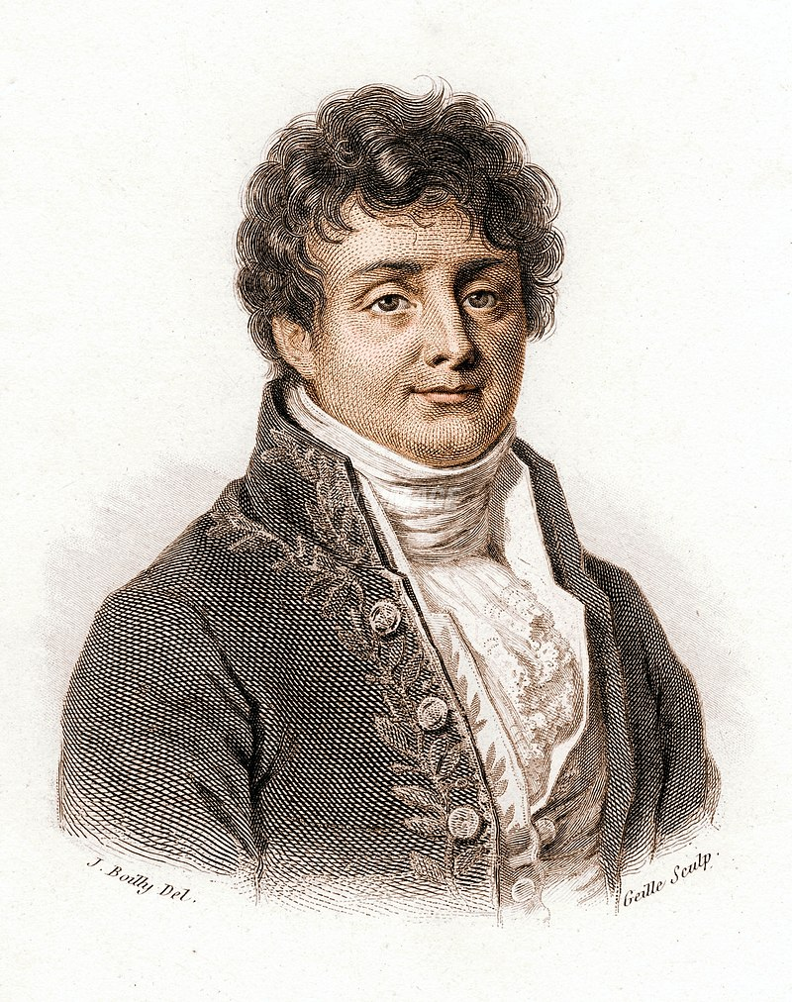
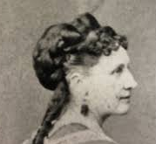
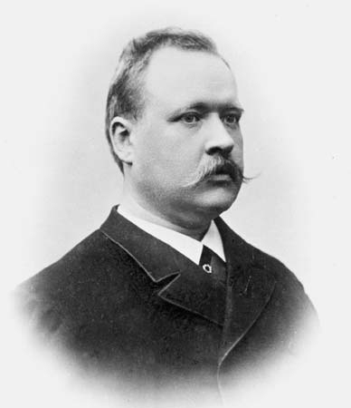
Climate Science Basics and History
Proved through experimentation that CO2 in the atmosphere is the main gas responsible for atmospheric warming. Also predicted that more CO2 would lead to more warming
Developed calculations predicting level of warming; double of CO2 would increase temps 5-6 Celsius.
1824 Joseph Fourier
1859 John Tyndall
Basic physics predict earth should be 60 degrees cooler than it is, hypothesized the atmosphere retained heat at the surface.
Confirmed and expanded on Fourier and Foote’s work. He also connected human activities and increases in heat trapping gasses.
1856 Eunice Newton Foote
1896 Svante Arrhenius
https://blog.ucsusa.org/katharine-hayhoe/climate-science-its-a-lot-older-than-you-think
https://climate.nasa.gov/news/2915/the-atmosphere-getting-a-handle-on-carbon-dioxide/
Notes:
GHG’s have doubled since first measured in 19th century

Slide 4
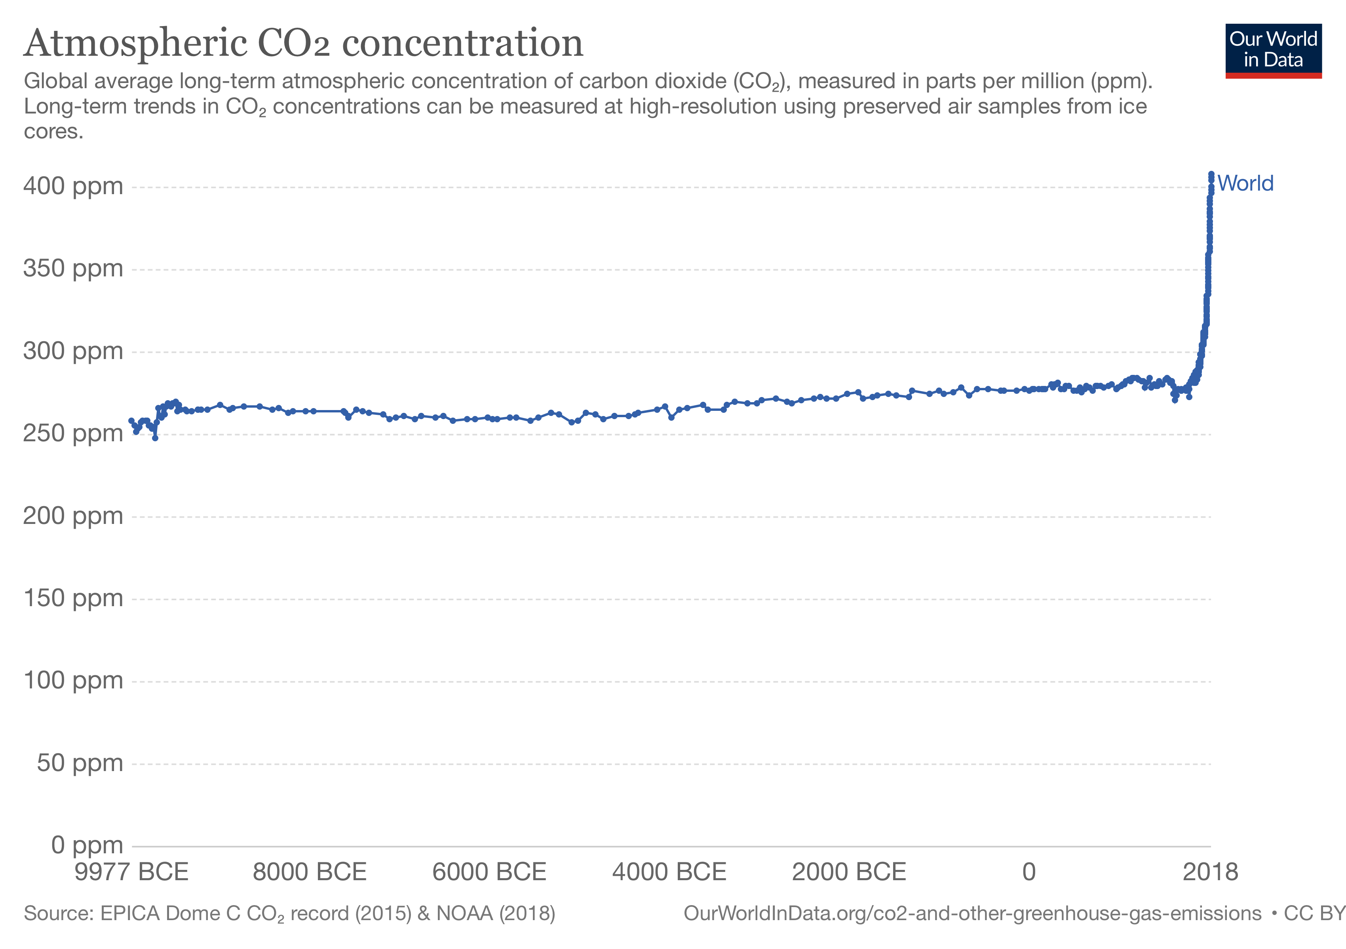
Notes:
Extra-ordinary processes are necessary to pull carbon out of the atmosphere in order to lower carbon concentrations in human time frames.
Carbon sequestration is deductive and appropriate in net-carbon accounting. However, many claims are made about net-carbon which simply trade the carbon emitted by one entity for credit from another entity which generated energy without emitting carbon. These trading schemes have utility in some cases and were important economic drivers of clean energy projects in the recent past but they can and often are used as greenwashing. A good example is when a fossil fuel like natural gas is burned for a process or use but the entity purchases solar or wind electricity credits to “offset” that use.
Global carbon concentrations are unaffected by such “offsets”.
Another example is planting trees to offset emissions, an average mature tree traps about 32 lbs. of carbon, it would require about 1,200 instantly mature trees to offset each individual’s carbon footprint in the Gunnison Valley.
For our purposes we will focus on gross emissions because the amount of emissions required to be cut in the very near future are too great to be wasting time with green washing math tricks.

Slide 5
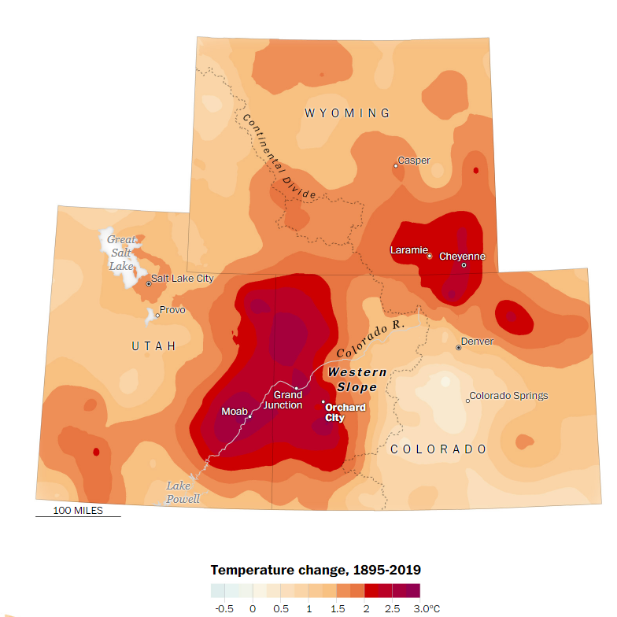
Climate Change is Happening and is Measurable
Parts of the Western Slope are already seeing average temperatures rise more than 2.5 Celsius
The commitments at the Paris accords would limit warming to +3 C.
Scientists say we need more aggressive goals to limit warming to +1.5 C to avoid the worst impacts
Source: Washington Post, Aug. 7, 2020 https://www.washingtonpost.com/graphics/2020/national/climate-environment/climate-change-colorado-utah-hot-spot/

Slide 6
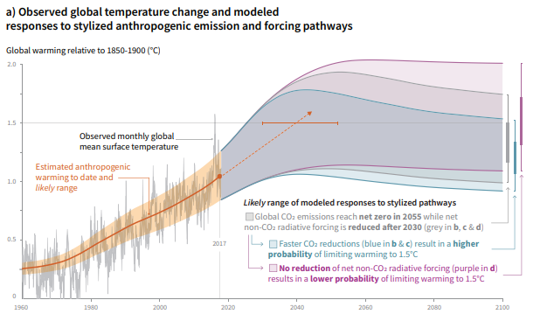
2018, IPCC SR15, “Summary for Policymakers”
Notes:
This graph represents a time period that encompasses our lifetimes. Most of us were born before impacts of anthropogenic climate change began to be measurable and will live to see the consequences.
Dealing with climate change is a moral obligation

Slide 7
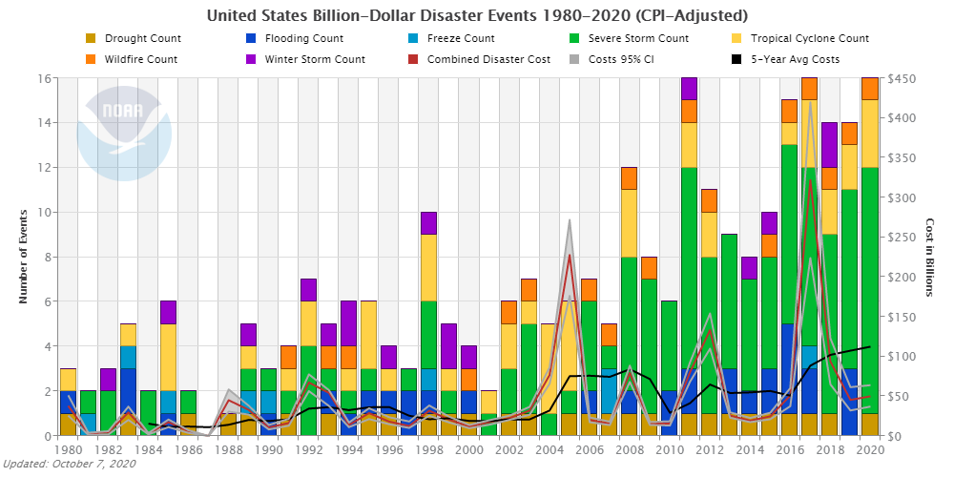
Costs of Climate Change Unsustainable
https://www.ncdc.noaa.gov/billions/time-series/US
Notes:
Costs of climate change are indirect and socialized.
Just like mining in the 19th century, profits are earned through use of natural resources but the impacts of the waste are left for society to deal with later.

Slide 8
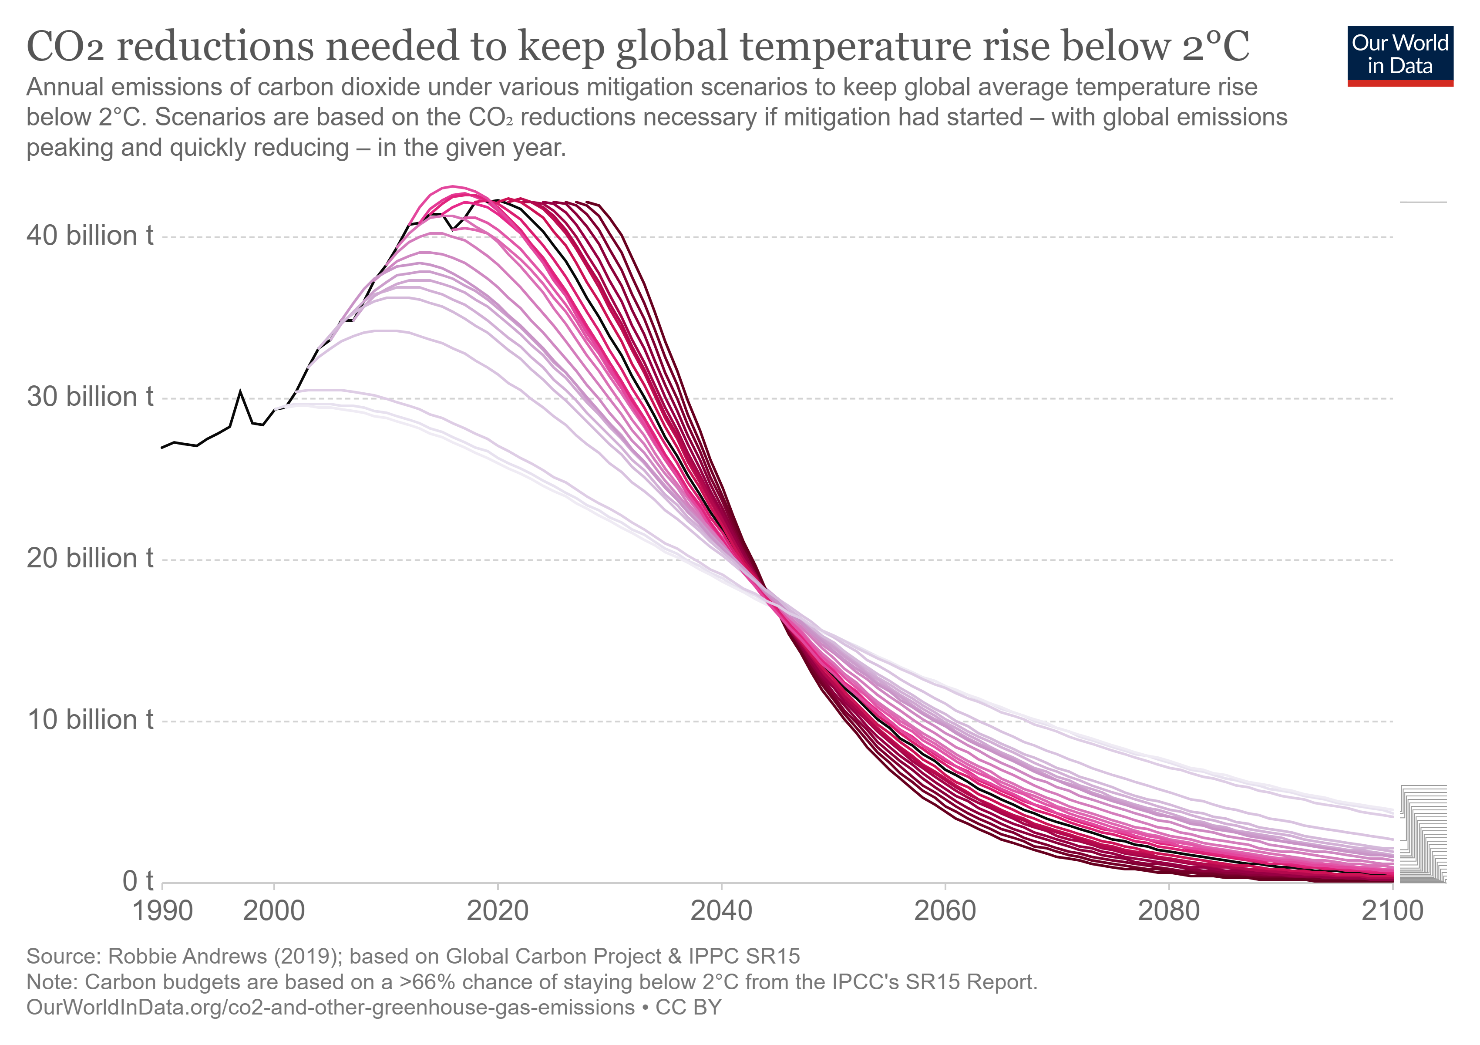
Notes:
This chart shows global emissions reductions that are necessary to keep global temperature rise below 1.5C
If serious efforts had been taken to reduce emissions back in 2000 or even 2008 the path would be less drastic. Every year that passes with no action requires more intense efforts. Now in 200 we need to cut emissions in half from current levels by 2030 and continue that trajectory after 2030.

Slide 9
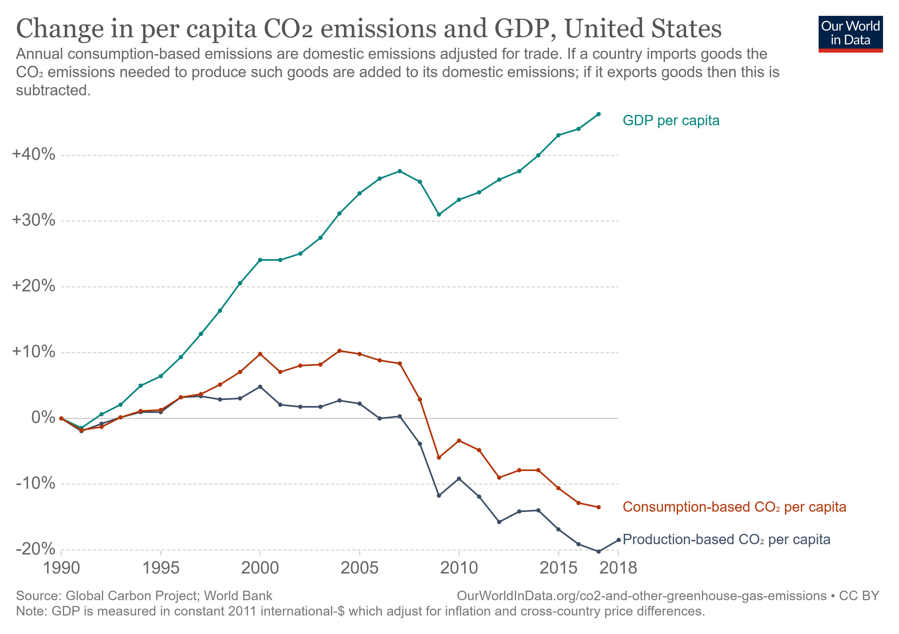
Economy and Emissions have Decoupled
Notes:
Lower emissions does not mean lowering economic growth.

Slide 10
Notes:
This is the county-wide GHG footprint. This includes all sectors and scopes including impacts that are caused by our activity but are indirect like fuel refining, food production, and cement manufacturing costs. We can affect the indirect emissions through our actions but we can only measure them through inference. For the remainder of the time we will be only considering scope 1 & 2 emissions which are directly attributed to actions here and more accurately measured. Scope 3 emissions are important but our goals will be based on more directly measurable scope 1 & 2.

Slide 11
To meet IPCC 1.5c goals Gunnison County must reduce its emissions to
45% by 2030
and to
Net-zero by 2050
2018, IPCC SR15, “Summary for Policymakers”
https://www.ipcc.ch/site/assets/uploads/sites/2/2019/06/SR15_Summary_Volume_Low_Res.pdf
Buildings = 61% Transport = 31% Landfill = 8%
Notes:
Talk about data collection methodology…
These charts depict the county’s emissions in two ways: By sector and by energy source
By sector: Buildings are a disproportionately large share of emissions in Gunnison County. Our average building is less efficient than buildings in the same climate zone as ours. Also, electrical emissions are greater on average than the rest of the country.
By energy source: Electricity is 42% of total emissions.

Slide 12
Emissions Forecast
2019 Current Policies
Emissions are projected to decrease by 6% by 2030 under current policies.
Emissions change by sector:
-Residential - 9%
-Commercial 9%
-Surface travel - 25%
-Air travel 21%
-Landfill 21%
Population growth:
-approx. 3100 people
-21% growth from 2015
-1471 additional residential units
Notes:
This incorporates recent policy changes into the forecasted emissions including CAFÉ standards and building energy code.
Recent policy changes will reduce emissions modestly driven primarily by increase in fuel efficiency because of Colorado adopting California’s tailpipe emissions and electrical vehicle standards. It also accounts for new energy code adoption which will lower residential energy use by about 9% while adding over 1400 homes.

Slide 13
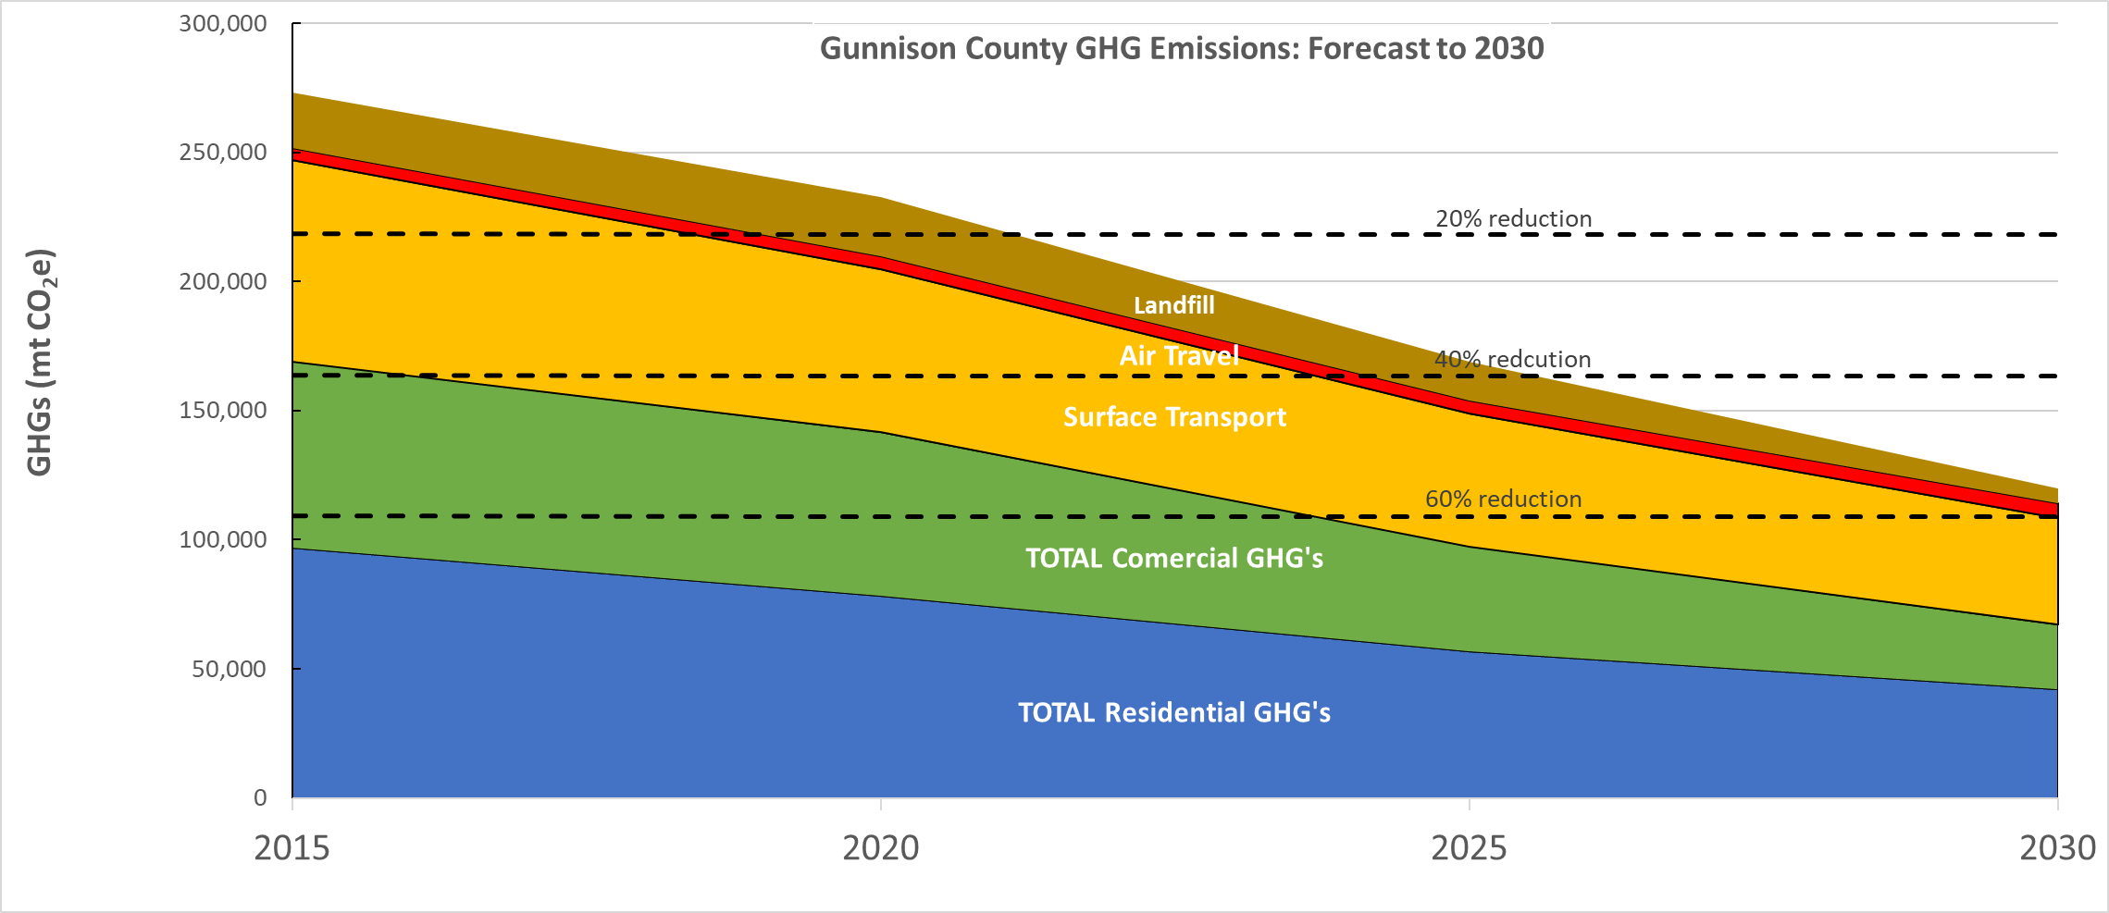
We can reduce emissions significantly
Notes:
This is possible through aggregate action in 4 main sectors: Electric Utilities, Building Efficiency, Transportation, and Land Use. Waste and recycling is another important sector that impacts climate change but doesn’t represent a significant portion of total emissions in the County.

Slide 14


Electric Utilities
The emissions factor (EF) is a measure of CO₂e per kWh.
Electric emissions are the main component of Buildings related emissions
GCEA
EF= .548 kgCO₂e/kWh
(1.21 lbsCO₂e/kWh)
Down from .735 kgCO₂e/kWh in 2015
City of Gunnison
EF = .510 kgCO₂e/kWh
(1.12 lbsCO₂e/kWh)

Slide 15
State of Colorado Electric emissions goals
Achieve State set goals of reducing emissions from the electric sector by 80% by 2030
Notes:
If the State’s goals were met and everything else remained as is today we would experience almost 30% reduction in emissions County wide.

Slide 16
County Support of State utility goals
Join CC4CA
BoCC provide comments to State leaders regarding climate action
Local Utilities
BoCC work with elected leadership of City and GCEA on climate policy
BoCC or County Staff represent County at public meetings of utilities

Slide 17
BUILDINGS
Buildings account for 61% of all greenhouse gas emissions in the County
Conditioned Commercial Space
Approx. 4,652,511 sq.ft.
Conditioned Residential Space
Approx. 17,787,523 sq.ft.

Slide 18
Buildings
Notes:
We expect to see energy use grow through 2030 but emissions will actually drop slightly because of GCEA’s emissions factor is expected to drop. This is based on the 2015? Tri-State resource plan.

Slide 19
BUILDINGS Efficiency
Residential Buildings and Affordability
ENERGY
Gunnison Average Residential
EUI = 51
Climate Zone 7 Average
EUI = 42
(EIA 2012)
2012 Energy Code
EUI = 35
COST
Gunnison Average Residential
$3,296 / yr
2012 IECC Compliant Average Cost
$2,262 / yr
Avg. Home vs. IECC
30 yr. Lifecycle Diff. $34,785
Assumes 1% energy escalation cost, 2020 dollars
By 2030 17% of all homes in Gunnison County will have been built to 2012 Energy Code or better
Notes:
The average home in Gunnison county uses 21% more energy than similar homes in Climate Zone 7. Homes meeting 2015 energy code will use 32% LESS energy than average in Gunnison county.
Deep energy cuts are possible: The Ryan Residence uses only 8% as much energy as the average in the county.

Slide 20
BUILDINGS Fuel Emissions
Notes:
Regarding emissions, fuel source and technology matter.
Today on a per Btu basis with the most common technology electricity is a emissions intensive way to heat. There are big changes coming though in the emissions factor from electricity dramatically lowering and with new technologies for electric heat. We will dive into this more over lunch and in the afternoon.

Slide 21
Buildings
By 2030:
Increase efficiency of Residential buildings by 20% to meet U.S. avg.
Increase efficiency of Commercial buildings by 40% to meet U.S. avg.
Notes:
These efficiencies would result in avg. EUI’s of 41 for residential and 84 for commercial buildings. Further, more efficient buildings require less heat and are easier to electrify, electric buildings will capitalize on utility emissions reductions and further reduce emissions.

Slide 22
County Policy Options for Buildings
Continuously adopt Energy Code revisions and fully implement
  Enforce blower door tests
Contractor licensing with continuing education requirements for building science
  Award program for high performers
Require energy code compliance, or reasonable effort to comply, during renovation projects
  Would need to consider what level of renovation would trigger
Energy benchmarking
  Support State reporting standard for buildings over 50,000 sq.ft.
  Require energy audit and reporting at time of sale or lease; Home Energy Score or other
Promote building efficiency and electrification
  Seek grants to support rebate programs
  Provide funding for GVHEAT
  On-bill financing or residential PACE program to pay for geothermal or other electrification

Slide 23
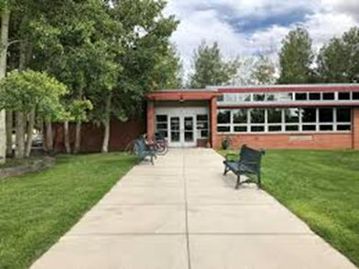
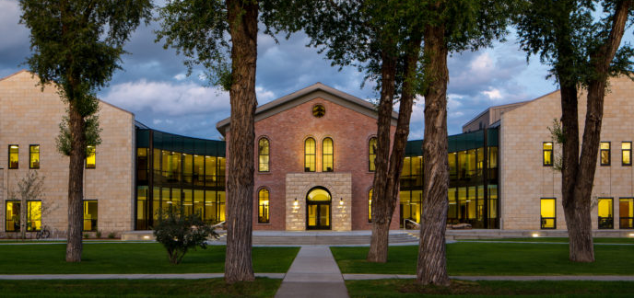
BUILDINGS Efficiency
Commercial Buildings
Gunnison Commercial Avg.
EUI = 140
Commercial Average
EUI = 86
2012 Energy Code
EUI = 61
(blended avg. all com buildings)
HHS
EUI = 31
Courthouse
EUI = 33
Notes:
Commercial buildings in the county use 62% more energy than the average commercial building in the US. Commercial buildings are more affected by occupancy than climate so benchmarking is not available by climate, just by occupancy type. For this purpose we used the average of all occupancy types.
Energy code compliant commercial buildings will use less than half the energy of current average.
Much deeper energy use is possible: the County has achieved EUI’s in public buildings that nearly half what energy code buildings would use.

Slide 24
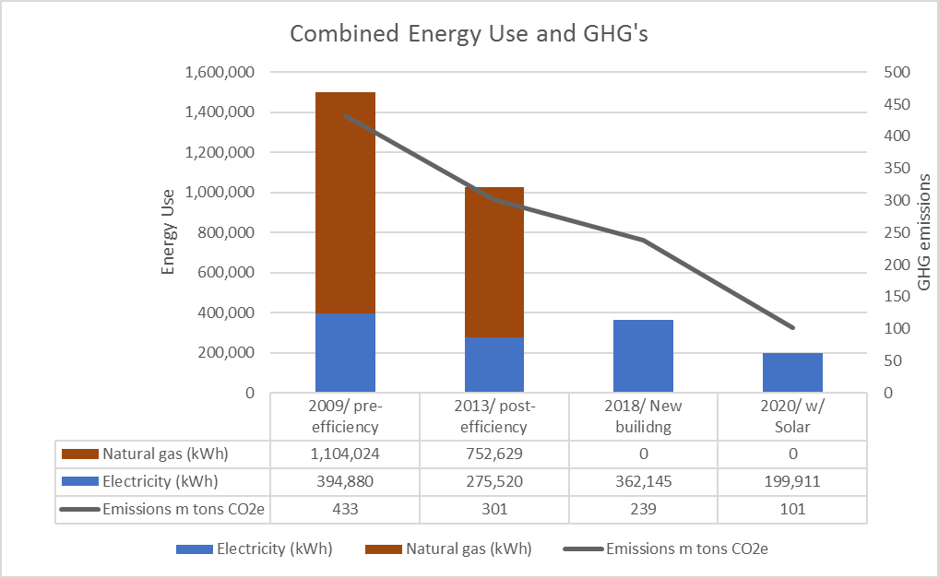
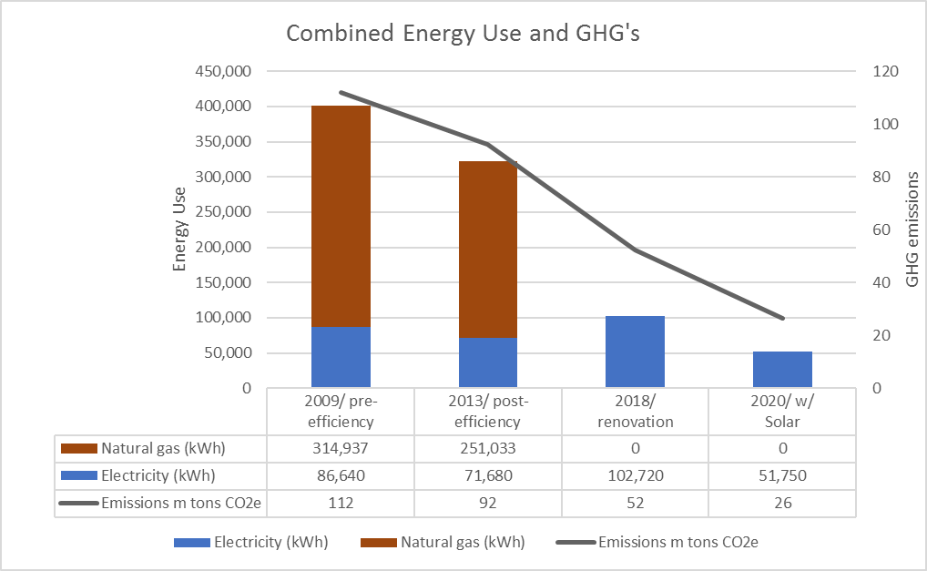
Major Energy Reductions in County Buildings
Courthouse
New construction 2015
Health and Human Services
Renovated 2018
Geothermal
Geothermal
Forecast PV
Forecast PV
Notes:
Through electrification and the use of heat pump technology energy use has been lowered dramatically. And all electric buildings are perfect for adding solar to.

Slide 25
Transportation
Surface Transport accounts for 29% of all greenhouse gas emissions in the county
Vehicle Miles Traveled (VMT)/ capita
Gunnison County
26.3
Colorado
24.0
VMT growth from 2015-18
18%
Population growth
4%
Annual avg. daily 5400
Local commuters
Notes:
In 1980 the avg. U.S. VMT per day was 18.6 it has grown every year since

Slide 26
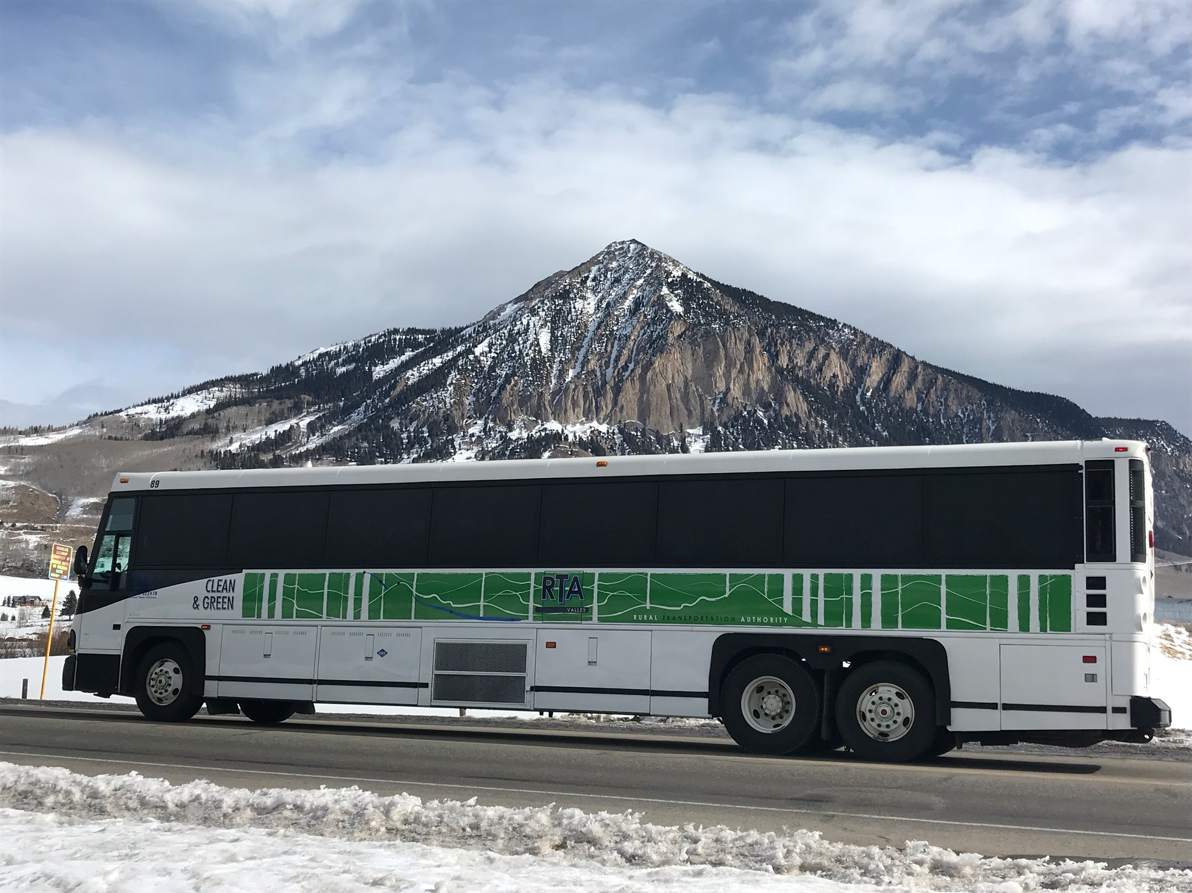
Transportation: RTA bus service
RTA Impact (2019)
224,718 one way passenger trips
141,332 one way car trips displaced/yr
Avg. 387 cars per day
Notes:
UPDATE WITH CURRENT DATA!!
RTA ridership represents about 1/10th the amount of cars on 135, or to put in another way RTA lowers traffic on 135 by 10%.

Slide 27
Colorado ZEV and LEV Standards
The adoption of “California” standards in Colorado
Average Fuel Economy
2015
Gas = 21.8
Diesel = 5.3
2030
Gas = 36.5
Diesel = 8.8
67% Increase in MPG
Includes population growth
Assumes flat per cap VMT
Notes:
The “California” standards will increase fuel economy by 67%
Assuming per capita VMT does not continue to increase the result will be a 28% overall decrease in emissions

Slide 28
Transportation: reduction in avg. VMT
By 2030 achieve 20% reduction from 26 miles/day to 21
Notes:
If VMT reduces by 20% by 2030 and “Cal” standards achieved

Slide 29
County Policy Options Transportation
Land Use
Create workforce housing stock near jobs
  Housing/ Jobs nexus
  Multimodal housing projects
Land Use
  Encourage density near population centers
  Discourage sprawl
Vehicles
Increase RTA bus frequency
Gunnison Circulator Bus
Parking fees
Electric vehicle charging infrastructure
Enforce “Rolling Coal” ban and illegal engine modifications
Notes:
Addressing emissions from transportation comes in 2 main areas: land use and alternative fuels. Land use changes including affordable housing will, over time, reduce commuting and encourage alternative modes of transportation.

Slide 30
Landfill
Landfill emissions are estimated at 8% of the total county emissions.
Emissions from landfill are primarily from decomposing organic waste which is emitted as methane
Annually we each contribute an average of 1 metric ton or 3.9 cubic yards of waste to the landfill
Notes:
Emissions from landfilled waste are estimated based on reporting from the State and utilizing EPA’s WARM calculator.
Actual emissions from landfills lag waste entombment, however for the emissions inventory emissions are estimated by the amount of waste that is landfilled.

Slide 31
Emissions Forecast
2019 Current Policies
Emissions are projected to decrease by 6% by 2030 under current policies.
Emissions change by sector:
-Residential - 9%
-Commercial 9%
-Surface travel - 25%
-Air travel 21%
-Landfill 21%
Population growth:
-approx. 3100 people
-21% growth from 2015
-1471 additional residential units
Notes:
So as a review: under current policies we are tracking at an estimated 6% emissions decrease with current implemented policies at the State and Local level. The State has set goals for drastic decreases in emissions from the electric sector and for ambitions electric vehicle adoption rates, we will model the potential effect of those this afternoon.

Slide 32
Waste: Organic waste diversion from landfill
By 2030 Divert 100% organic waste from landfill
Could reduce waste emissions by 50% or about 13,000 mt.
Notes:
In 1980 the avg. U.S. VMT per day was 18.6 it has grown every year since

Slide 33
Aggregate of all goals
Notes:
This is what is possible

